Slide 1

Data Structures and Algorithms Instructor: Maira Sami
maira.sami@szabist.edu.pk
Campus 154
Room No. 02

Slide 2
Arrays
Lecture 2

Slide 3
Arrays
An array is a collection of homogeneous data elements described by a single name.
Each element of an array is referenced by an index enclosed in parenthesis.
If an element of an array is referenced by single subscript, then the array is known as one dimensional array or linear array and if two subscripts are required to reference an element, the array is known as two dimensional array and so on.
Notes:
Y an

Slide 4
ONE DIMENSIONAL ARRAY
One-dimensional array (or linear array) is a set of ‘n’ finite numbers of homogenous data elements such as :
The elements of the array are referenced respectively by an index set consisting of ‘n’ consecutive numbers.
The elements of the array are stored respectively in successive memory locations.

Slide 5
Arrays
The entire array
has a single name
Each value has a numeric index
An array is an ordered list of values
0 1 2 3 4 5 6 7 8 9
scores
79 87 94 82 67 98 87 81 74 91
An array of size N is indexed from zero to N-1
This array holds 10 values that are indexed from 0 to 9

Slide 6
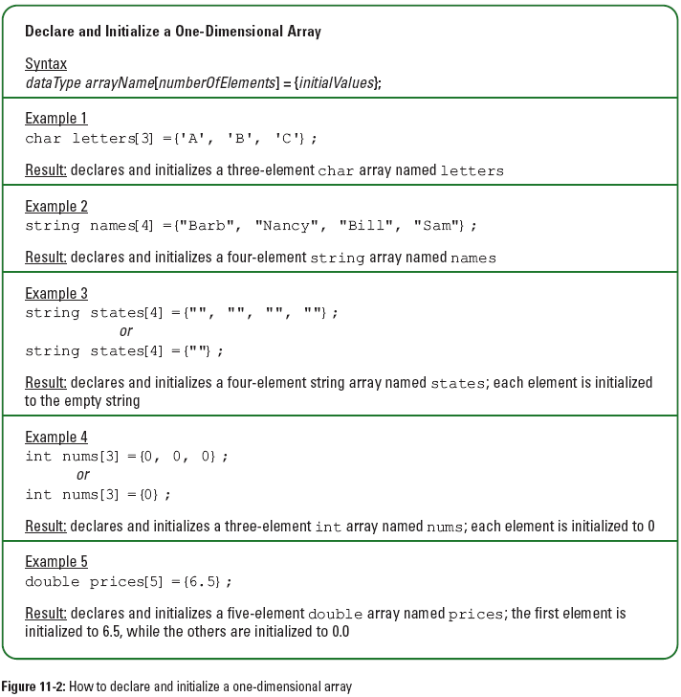
One-Dimensional Arrays (continued)

Slide 7
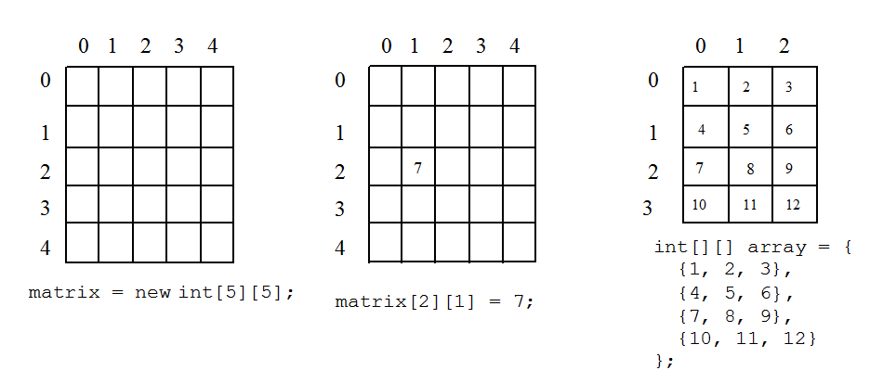
Multidimensional Array/2D Arrays
The elements of a 2-dimensional array a declared as:
int a[3][4];
may be shown as a table
a[0][0] a[0][1] a[0][2] a[0][3]
a[1][0] a[1][1] a[1][2] a[1][3]
a[2][0] a[2][1] a[2][2] a[2][3]

Slide 8
Rows Of A 2D Array
a[0][0] a[0][1] a[0][2] a[0][3] row 0
a[1][0] a[1][1] a[1][2] a[1][3] row 1
a[2][0] a[2][1] a[2][2] a[2][3] row 2

Slide 9
Columns Of A 2D Array
a[0][0] a[0][1] a[0][2] a[0][3]
a[1][0] a[1][1] a[1][2] a[1][3]
a[2][0] a[2][1] a[2][2] a[2][3]
column 0
column 1
column 2
column 3

Slide 10
Two-Dimensional Arrays (continued)

Slide 11
Two-Dimensional Arrays (continued)

Slide 12
2D Array Representation In C++
2-dimensional array x
a, b, c, d
e, f, g, h
i, j, k, l
view 2D array as a 1D array of rows
x = [row0, row1, row 2]
row 0 = [a,b, c, d]
row 1 = [e, f, g, h]
row 2 = [i, j, k, l]
and store as 4 1D arrays

Slide 13
2D Array Representation In C++
x[]
a
b
c
d
e
f
g
h
i
j
k
l
4 separate 1-dimensional arrays
x.length = 3
x[0].length = x[1].length = x[2].length = 4
Notes:
The 4 separate arrays are x, x[0], x[1], and x[2].

Slide 14
Row-Major Mapping
In computing, row-major order and column-major order describe methods for storing multidimensional arrays in linear memory.
Example 3 x 4 array:
a b c d
e f g h
i j k l
Convert into 1D array y by collecting elements by rows.
Within a row elements are collected from left to right.
Rows are collected from top to bottom.
We get y[] = {a, b, c, d, e, f, g, h, i, j, k, l}
row 0
row 1
row 2
…
row i

Slide 15
Column-Major Mapping
a b c d
e f g h
i j k l
Convert into 1D array y by collecting elements by columns.
Within a column elements are collected from top to bottom.
Columns are collected from left to right.
We get y = {a, e, i, b, f, j, c, g, k, d, h, l}

Slide 16
Array operations
Array traversal
Insertion
Deletion
Searching
Sorting

Slide 17
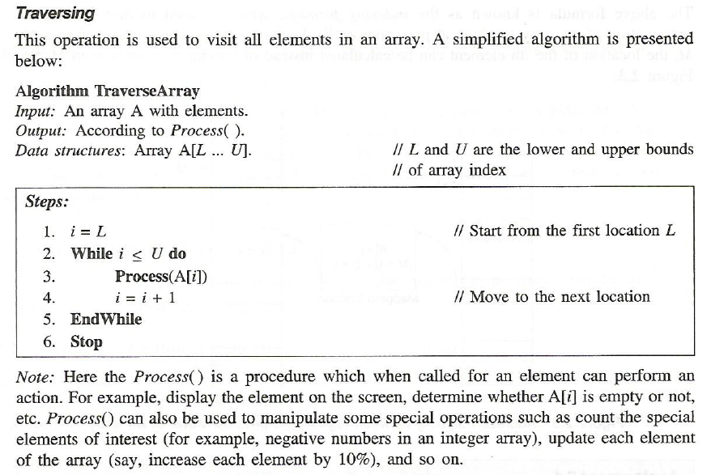

Slide 18
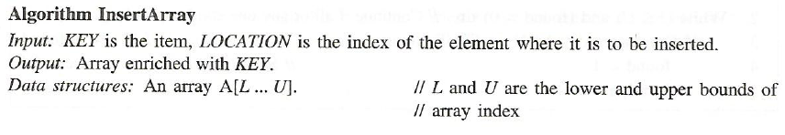
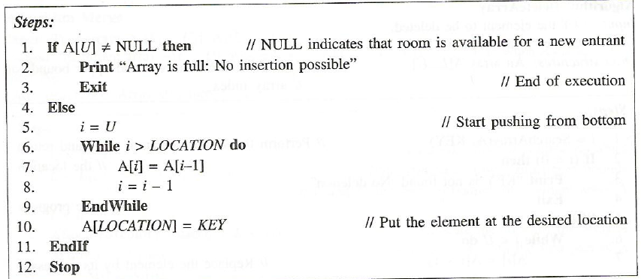

Slide 19
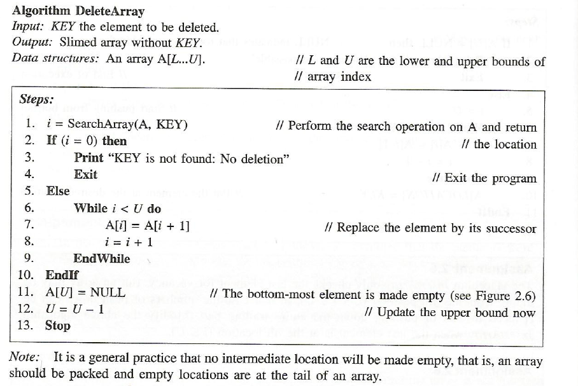

Slide 20
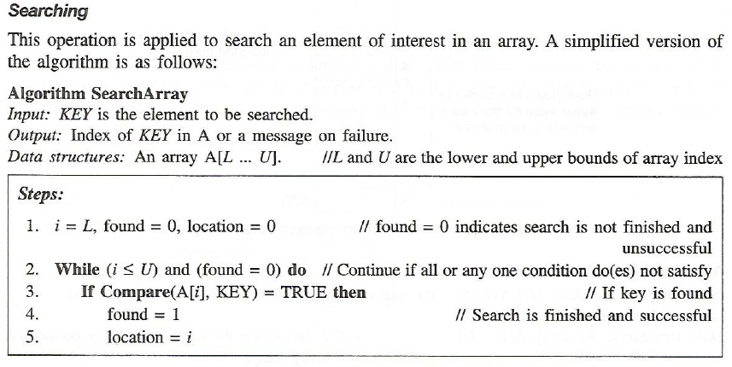
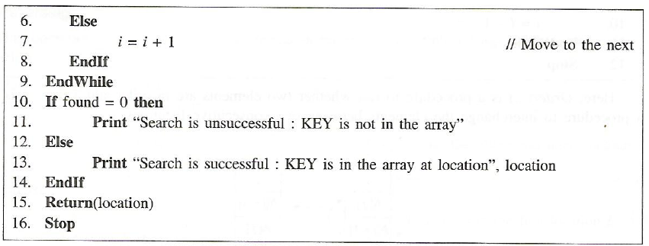

Slide 21
Time complexity of various array operations
Accessing an element in array
Best case:
Worst case:
Insertion and deletion
Best case:
Worst case
Array Traversal
Theta
Here is best and worst case are same
Searching
Best case:
Worst case:

Slide 22
Difference between Stack and Array Data Structures:
STACKS | ARRAY
Stacks are based on the LIFO principle, i.e., the element inserted at the last, is the first element to come out of the list. | In the array the elements belong to indexes, i.e., if you want to get into the fourth element you have to write the variable name with its index or location within the square bracket eg arr[4]
Insertion and deletion in stacks takes place only from one end of the list called the top. | Insertion and deletion in array can be done at any index in the array.
Stack has a dynamic size. | Array has a fixed size.
Stack can contain elements of different data type. | Array contains elements of same data type.
We can do only linear search | We can do both linear and Binary search

